Slide 1
Backend Web Development Session (1)
By Ahmed Mamdouh

Slide 2
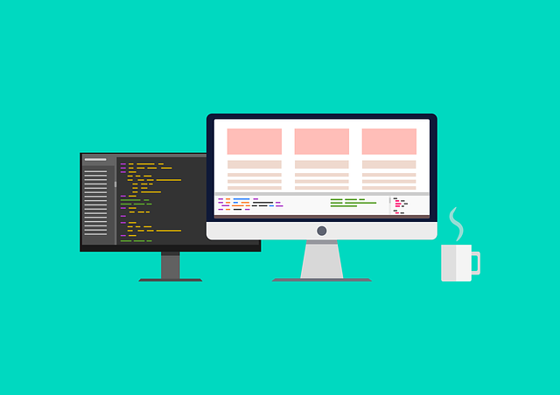

Frontend vs. Backend Web Development
Frontend Web Development | Backend Web Development
Client-side | Server-side
Creates the user interface which the user sees and interacts with directly | Creates the behind-the-scenes activities which happen when the user interacts with the website
Used technologies: HTML, CSS, JavaScript | Used technologies: Server-side Programming Language (PHP, Python, C#, Ruby, Java, JavaScript (NodeJS)), Database Management System (MySQL, PostreSQL, MongoDB), Web Server (Nginx, Apache, IIS)

Slide 3
Static Websites
In the past websites were static which means that the content was always the same for every user.
Static websites were composed of HTML files linked to each other using hyperlinks.
Static website weren’t efficient as changing content meant editing the source code of the HTML file.
Now static websites are only used in cases of small website whose content doesn’t change constantly.

Slide 4
Dynamic Websites
Due to the rapid changes in data most of the websites nowadays are dynamic which means that the content varies according to the user and changes constantly.
Dynamic websites rely on programming languages and databases to save and view their content to the users.
Changing the content on dynamic websites is easy and efficient, it is as easy as filling a form.
Dynamic websites display content to users through some logic devised by the backend developer.

Slide 5
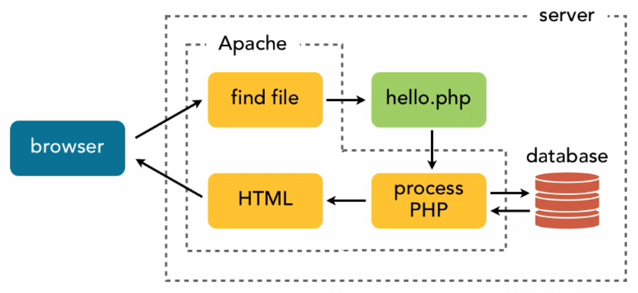
How do websites work? (Request/Response)

Slide 6

LAMP Stack
Linux (Operating Server)
Apache (Web Server)
MySQL (Database Management System)
PHP (Server-side Programming Language)

Slide 7

PHP (PHP: Hypertext Preprocessor)
PHP is an open-source server-side scripting language
The first iteration of PHP was released on 1994
PHP is currently in version 7.4
Examples of websites build on PHP: Facebook, Wikipedia, Tumblr and Wordpress

Slide 8
Data Types in PHP
PHP supports the following data types:-
String (string of characters ex. “PHP”)
Integer (whole numbers with no floating point ex. 1738267, -95)
Float (decimal numbers ex. 123.41238, -32.1234)
Boolean (true or false)
Array (variables that can hold more than one value at a time)
Object (will be discussed in OOP)
Resource (special data type referencing to external resource ex. files)
NULL (null)

Slide 9
Variables in PHP
Sometimes we need to reuse some values multiple times throughout our code.
For reusability nearly all programming languages contain variables which can be considered containers for storing data in the memory.
To declare a variable in PHP the variable must start with “$” then the name of the variable.
Variable name must only contain alpha-numeric characters and underscores (A-z, 0-9, _)
Variable name can’t start with a number (can only start in an underscore or an alphabetic character)

Slide 10
Operators in PHP
Most of the time we need to perform operations on data, whether these operations be comparisons, calculations or string manipulation.
That’s why all programming languages have many types of operators to perform these operations
Types of operators in PHP:-
Assignment operators
Arithmetic operators
Comparison operators
Logical operators
Concatenation operator

Slide 11
Assignment Operators
Assignment operators are used to assign a certain value to a variable.
The most commonly used assignment operator is the = operators.
The value on the right hand side is assigned to the variable on the left hand side.
Example: $x = 2;
There are more assignment operators that perform an operation and then assigns the result to the value on the left hand side
Examples: =, +=, -=, *=, /=, .=

Slide 12
Arithmetic Operators
Arithmetic operators are used to perform calculations on its operands.
The operations that have operators natively in PHP are addition, subtraction, multiplication, division and modulus (calculating the reminder of division)
Addition (+)
Subtraction (-)
Multiplication (*)
Division (/)
Modulus (%)

Slide 13
Comparison Operators
Comparison operators are used to evaluate an expression.
The result of a comparison expression is always a Boolean as the expression can only be true or false.
Equals (==, ===)
Greater Than (>)
Greater Than or Equal (>=)
Less Than (<)
Less Than or Equal (<=)
Not Equal (!=, !==)

Slide 14
Logical Operators
Sometimes we need to check the validity of more than one expression.
In this case we have to combine some conditional statements and check their validity.
Logical operators help us check the validity of multiple expressions
AND operator (&&), $x && $y (returns true only if $x and $y are true)
OR operator (||), $x || $y (returns true if one of $x or $y is true)
NOT operator (!), if $x is true then !$x is false and vice versa.

Slide 15
Concatenation Operators
In many cases we may want to attach two strings together.
This is called concatenation, in most programming languages the “+” is used as a concatenation operator when it is used with strings.
In PHP this is not the case, there is a special operator called the concatenation operator and it is the “.”.
Example: The result of “Hello ” . “World” is “Hello World”.

